Slide 1


Testing Procedures for Operational Issues
TechnoReady In-Mexico.
8th Challenge
Johan Alejandro Gloria González, NAO ID: 3346
Iván Kaleb Ramírez Torres, NAO ID: 3357

Slide 2
Introduction: Equivalence Classes
What we'll cover:
SCRUM: An agile framework for teamwork and project management.
JSON: A versatile data-interchange format for web applications.
CSV: A simple, tabular format for data storage and sharing.
The Big Picture: Why are these three concepts so important and how do they work together in real-world projects?

Slide 3
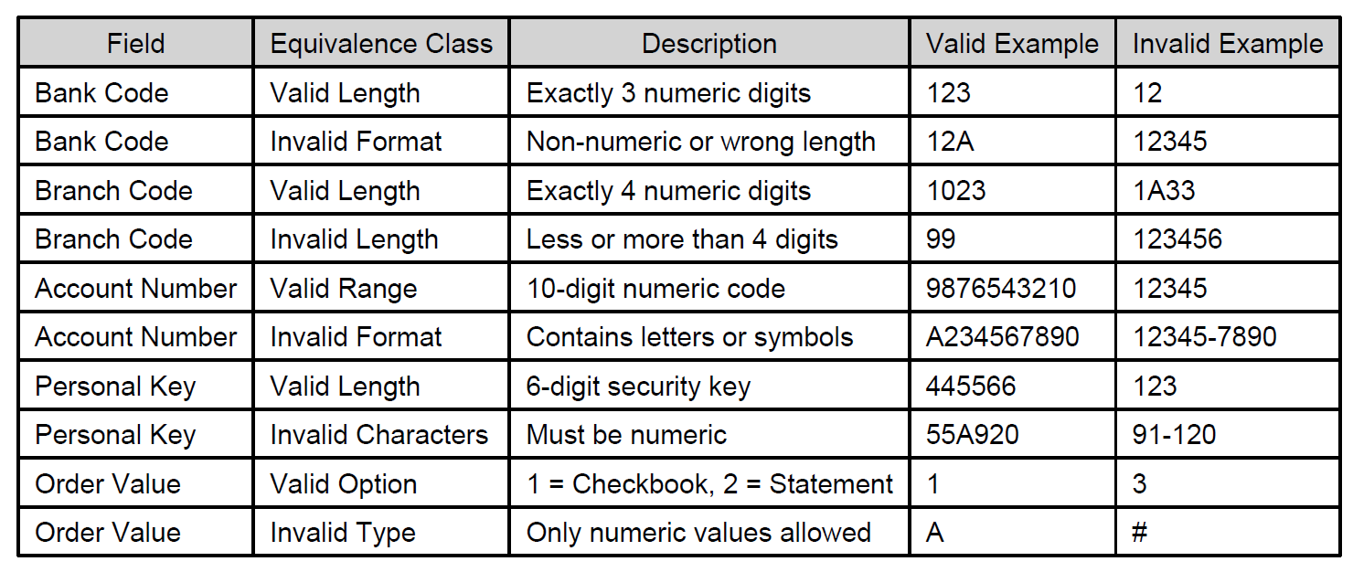
Equivalence Classes

Slide 4

Why these classes were selected?
Definition: An agile framework for managing complex projects and delivering products in an iterative, incremental manner.
Key Idea: Instead of one long project plan, SCRUM breaks work into small, manageable cycles called Sprints.
Benefits:
Flexibility: Easily adapt to changing requirements.
Collaboration: Fosters close teamwork and communication.
Transparency: Everyone knows the project's status at all times.
Notes:
What is SCRUM?

Slide 5
Costs

Slide 6
Sustainability

Slide 7
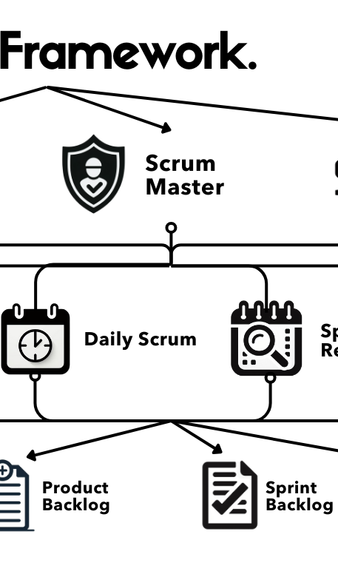
The Three Pillars of SCRUM
- Roles:
  Product Owner: Defines and prioritizes the work (the "what").
  Scrum Master: Facilitates the process and removes obstacles (the "how").
  Development Team: Builds the product.
- Events:
  Sprint Planning: What will be done this Sprint?
  Daily Scrum: A quick daily meeting to sync up.
  Sprint Review: Demonstrate the completed work.
  Sprint Retrospective: What can we improve for the next Sprint?
- Artifacts:
  - Product Backlog: A prioritized list of all features.
  - Sprint Backlog: The subset of features for the current Sprint.
  - Increment: The potentially shippable product from the Sprint.
Notes:
SCRUM's Core Components

Slide 8

JSON: The Language of Web Data
- Definition: JavaScript Object Notation. A lightweight, human-readable format for storing and exchanging data.
- Characteristics:
  Language-independent: Usable with any programming language.
  Key-Value Pairs: Data is organized in key-value pairs (like a dictionary).
  Structured: Uses {} for objects and [] for arrays.
Common Use Cases:
  APIs: The standard format for communication between a client (like a web browser) and a server.
  Configuration Files: Storing settings for applications.
Notes:
Introduction to JSON

Slide 9
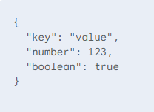
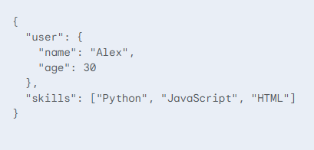
Diving Deeper into JSON Syntax
Basic Structure:
Nested Objects and Arrays:
Notes:
JSON Syntax and Examples

Slide 10

CSV: The Spreadsheet of the Web
Definition: Comma Separated Values. A simple text file format used to store tabular data.
Characteristics:
- Plain Text: Readable with any text editor.
- Tabular: Data is organized in rows and columns.
- Delimiter: Values in each row are separated by a delimiter, most commonly a comma (,).
Common Use Cases:
- Data Export/Import: Easily move data between spreadsheets and databases.
- Data Archiving: Storing large datasets in a simple, compact format.
Notes:
Introduction to CSV

Slide 11
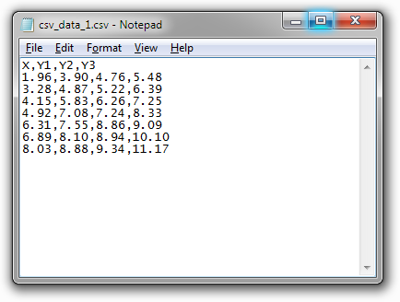
Understanding CSV Structure
Basic Structure:
Name,Age,City
Alice,28,New York
Bob,35,London
Handling Commas in Data:
  If a value contains a comma, it must be enclosed in double quotes.
  Example: "Alex, Jr.",25,"Mexico City“
Data Types: All data is treated as plain text, requiring careful handling when parsing.
Notes:
CSV Syntax and Examples

Slide 12
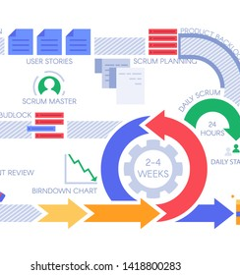
The Complete Workflow
Step 1: Planning (SCRUM): The team uses SCRUM to plan a new feature, like adding a "User Profile" section.
Step 2: Data Exchange (JSON): The frontend requests a user's data from the backend using an API, which responds with the user's information in JSON format.
Step 3: Data Management (CSV): The analytics team needs to export a list of all users' data for a report. They use a tool to generate a CSV file from the database.
Notes:
SCRUM, JSON, and CSV in Action

Slide 13
Summary and Key Takeaways
SCRUM: The "how" of project management. It provides the framework for teams to work efficiently.
JSON: The "what" of web data. It's the flexible, structured language for modern applications.
CSV: The simple, reliable format for data storage and sharing.
Together, they form a powerful combination: SCRUM organizes the people, while JSON and CSV handle the data.
Notes:
Conclusion and Q&A

